Slide 1
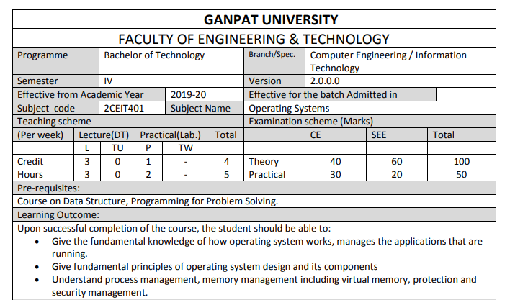

Slide 2
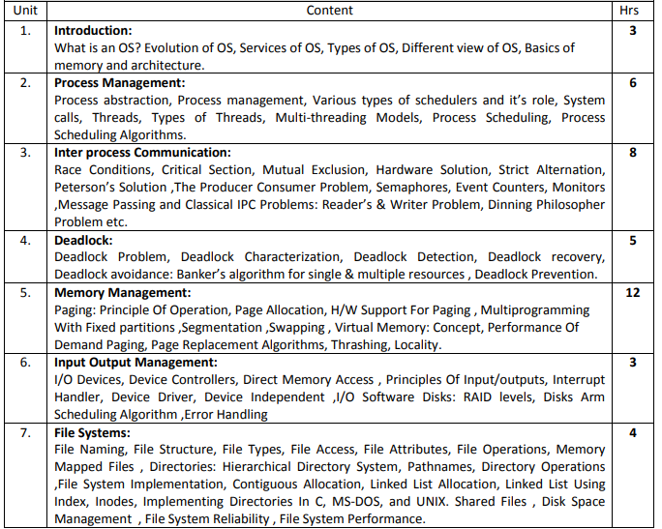

Slide 3
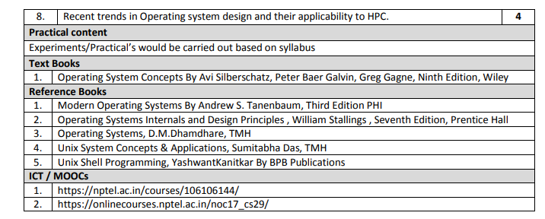

Slide 4
Unit-1:Introduction
What is an Operating System?
Computer-System Organization
Operating-System Structure
Operating-System Operations
Process Management
Memory Management
Storage Management
Protection and Security
Kernel Data Structures
Computing Environments
Open-Source Operating Systems
Computer-System Architecture

Slide 5
Objectives
To describe the basic organization of computer systems
To provide a grand tour of the major components of operating systems
To give an overview of the many types of computing environments
To explore several open-source operating systems

Slide 6
1. What is an Operating System?
A program that acts as an intermediary between a user of a computer and the computer hardware
Operating system goals:
  Execute user programs and make solving user problems easier
  Make the computer system convenient to use
  Use the computer hardware in an efficient manner

Slide 7
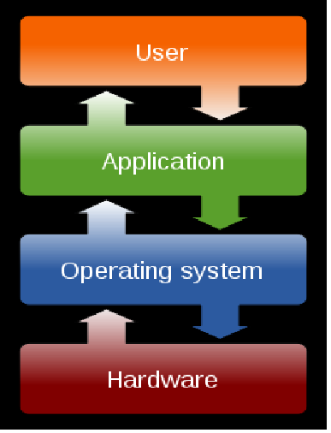

Slide 8
Computer System Structure
Computer system can be divided into four components:
  Hardware – provides basic computing resources
    CPU, memory, I/O devices
  Operating system
    Controls and coordinates use of hardware among various applications and users
  Application programs – define the ways in which the system resources are used to solve the computing problems of the users
    Word processors, compilers, web browsers, database systems, video games
  Users
    People, machines, other computers

Slide 9

2.Four Components of a Computer System

Slide 10
3.What Operating Systems Do
The operating system controls the hardware and coordinates its use among the various application programs for the various users.
We can also view a computer system as consisting of hardware, software, and data.
The operating system provides the means for proper use of these resources in the operation of the computer system.
An operating system is similar to a government. Like a government, it performs no useful function by itself. It simply provides an environment within which other programs can do useful work.
To understand more fully the operating system's role, we explore operating systems from two viewpoints:
  The user
  The system.

Slide 11
User View
The user's view of the computer varies according to the interface being used
Single user computers (e.g., PC, workstations). Such systems are designed for one user to monopolize its resources. The goal is to maximize the work (or play) that the user is performing. the operating system is designed mostly for ease of use and good performance.
Multi user computers (e.g., mainframes, computing servers). These users share resources and may exchange information. The operating system in such cases is designed to maximize resource utilization -- to assure that all available CPU time, memory, and I/O are used efficiently and that no individual users takes more than their air share.

Slide 12
User View (Cont.)
Handheld computers (e.g., smartphones and tablets). The user interface for mobile computers generally features a touch screen. The systems are resource poor, optimized for usability and battery life.
Embedded computers (e.g., computers in home devices and automobiles) The user interface may have numeric keypads and may turn indicator lights on or off to show status. The operating systems are designed primarily to run without user intervention.

Slide 13
System View
From the computer's point of view, the operating system is the program most intimately involved with the hardware. There are two different views:
The operating system is a resource allocator
  Manages all resources
  Decides between conflicting requests for efficient and fair resource use
The operating systems is a control program
  Controls execution of programs to prevent errors and improper use of the computer

Slide 14
4.Evolution of Computer Systems
Users
Applications
Database System
Operating System
Hardware

Slide 15
…
Early Systems (1950)
Simple Batch Systems (1960)
Multiprogrammed Batch Systems (1970)
Time-Sharing and Real-Time Systems (1970)
Personal/Desktop Computers (1980)
Multiprocessor Systems (1980)
Networked/Distributed Systems (1980)
Web-based Systems (1990)

Slide 16
5. Computer-System Organization
A modern general-purpose computer system consists of one or more CPUs and a number of device controllers connected through a common bus that provides access to shared memory.
Each device controller is in charge of a specific type of device (for example, disk drives, audio devices, or video displays). Each device controller has a local buffer.
CPU moves data from/to main memory to/from local buffers.
The CPU and the device controllers can execute in parallel, competing for memory cycles. To ensure orderly access to the shared memory, a memory controller synchronizes access to the memory.

Slide 17

6. Modern Computer System

Slide 18
7. Computer Startup
Bootstrap program is loaded at power-up or reboot
  Typically stored in ROM or EPROM, generally known as firmware
  Initializes all aspects of system
  Loads operating system kernel and starts execution

Slide 19
8. Computer-System Operation
Once the kernel is loaded and executing, it can start providing services to the system and its users.
Some services are provided outside of the kernel, by system programs that are loaded into memory at boot time to become system processes, or system daemons that run the entire time the kernel is running.
On UNIX, the first system process is init and it starts many other daemons. Once this phase is complete, the system is fully booted, and the system waits for some event to occur.
The occurrence of an event is usually signaled by an interrupt.

Slide 20
Interrupts
There are two types of interrupts:
  Hardware -- a device may trigger an interrupt by sending a signal to the CPU, usually by way of the system bus.
  Software -- a program may trigger an interrupt by executing a special operation called a system call.
A software-generated interrupt (sometimes called trap or exception) is caused either by an error (e.g., divide by zero) or a user request (e.g., an I/O request).
An operating system is interrupt driven.

Slide 21
Common Functions of Interrupts
When an interrupt occurs, the operating system preserves the state of the CPU by storing the registers and the program counter
Determines which type of interrupt has occurred and transfers control to the interrupt-service routine.
An interrupt-service routine is a collection of routines (modules), each of which is responsible for handling one particular interrupt (e.g., from a printer, from a disk)
The transfer is generally through the interrupt vector, which contains the addresses of all the service routines
Interrupt architecture must save the address of the interrupted instruction.

Slide 22
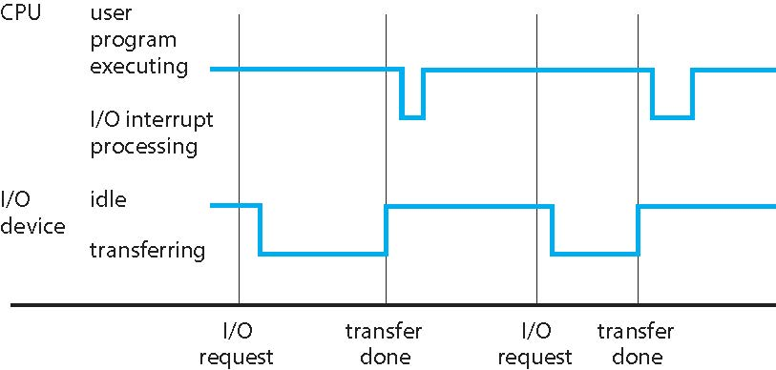
Interrupt Timeline

Slide 23
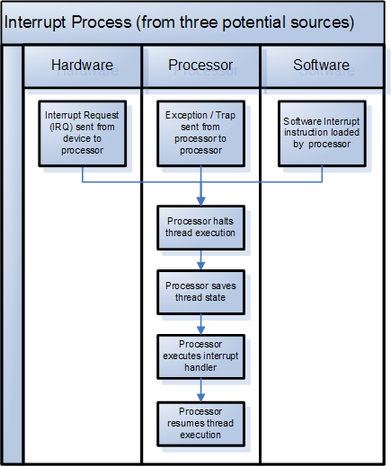

Slide 24
9. Storage Structure
Main memory – the only large storage media that the CPU can access directly
  Random access
  Typically volatile
Secondary storage – extension of main memory that provides large nonvolatile storage capacity
  Hard disks – rigid metal or glass platters covered with magnetic recording material
    Disk surface is logically divided into tracks, which are subdivided into sectors
    The disk controller determines the logical interaction between the device and the computer
  Solid-state disks – faster than hard disks, nonvolatile
    Various technologies
    Becoming more popular
Tertiary storage

Slide 25
Storage Definition
The basic unit of computer storage is the bit. A bit can contain one of two values, 0 and 1. All other storage in a computer is based on collections of bits.
A byte is 8 bits, and on most computers it is the smallest convenient chunk of storage.
A less common term is word, which is a given computer architecture’s native unit of data. A word is made up of one or more bytes.

Slide 26
Storage Definition (Cont.)
Computer storage, along with most computer throughput, is generally measured and manipulated in bytes and collections of bytes.
  A kilobyte, or KB, is 1,024 bytes
  a megabyte, or MB, is 1,024² bytes
  a gigabyte, or GB, is 1,024³ bytes
  a terabyte, or TB, is 1,024⁴ bytes
  a petabyte, or PB, is 1,024⁵ bytes
  exabyte, zettabyte, yottabyte
Computer manufacturers often round off these numbers and say that a megabyte is 1 million bytes and a gigabyte is 1 billion bytes. Networking measurements are an exception to this general rule; they are given in bits (because networks move data a bit at a time).

Slide 27
Storage Hierarchy
Storage systems organized in hierarchy
  Speed
  Cost
  Volatility
Caching – copying information from “slow” storage into faster storage system;
  Main memory can be viewed as a cache for secondary storage
Device Driver for each device controller to manage I/O
  Provides uniform interface between controller and kernel

Slide 28
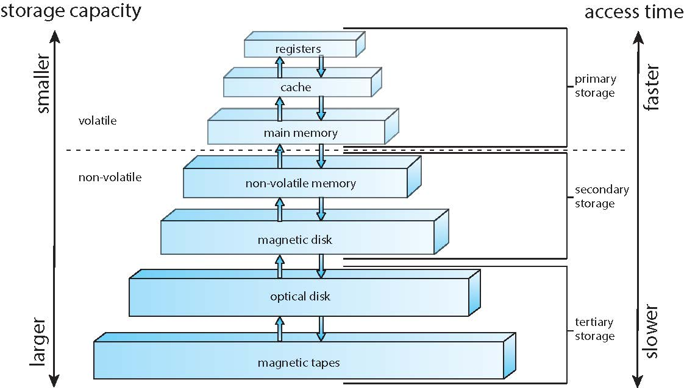
Storage-device hierarchy

Slide 29
11. Direct Memory Access Structure
Interrupt-driven I/O is fine for moving small amounts of data but can produce high overhead when used for bulk data movement such as disk I/O.
To solve this problem, direct memory access (DMA) is used.
  After setting up buffers, pointers, and counters for the I/O device, the device controller transfers an entire block of data directly to or from its own buffer storage to memory, with no intervention by the CPU.
  Only one interrupt is generated per block, to tell the device driver that the operation has completed. While the device controller s performing these operations, the CPU is available to accomplish other work.
Some high-end systems use switch rather than bus architecture. On these systems, multiple components can talk to other components concurrently, rather than competing for cycles on a shared bus. In this case, DMA is even more effective. The figure in next slide shows the interplay of all components of a computer system.

Slide 30

How a Modern Computer Works
A von Neumann architecture and a depiction of the interplay of all components of a computer system.

Slide 31
13. Modes of Operation
A mechanism that allows the OS to protect itself and other system components
Two modes:
  User mode
  Kernel mode
Mode bit (0 or 1) provided by hardware
  Provides ability to distinguish when system is running user code or kernel code
  Some instructions designated as privileged, only executable in kernel mode
  Systems call by a user asking the OS to perform some function changes from user mode to kernel mode.
  Return from a system call resets the mode to user mode.

Slide 32

Transition from User to Kernel Mode

Slide 33
14. Timer
To prevent process to be in infinite loop (process hogging resources), a timer is used, which is a hardware device.
Timer is a counter that is decremented by the physical clock.
Timer is set to interrupt the computer after some time period
Operating system sets the counter (privileged instruction)
When counter reaches the value zero, and interrupt is generated.
The OS sets up the value of the counter before scheduling a process to regain control or terminate program that exceeds allotted time

Slide 34
15. Process Management (OS Functions)
A process is a program in execution. It is a unit of work within the system. Program is a passive entity, process is an active entity.
Process needs resources to accomplish its task
  CPU, memory, I/O, files, etc.
  Initialization data
Process termination requires reclaim of any reusable resources
A thread is a basic unit of CPU utilization within a process.
  Single-threaded process. Instructions are executed sequentially, one at a time, until completion
  Process has one program counter specifying location of next instruction to execute
Multi-threaded process has one program counter per thread
Typically, a system has many processes, some user, some operating system running concurrently on one or more CPUs
  Concurrency by multiplexing the CPUs among the threads

Slide 35
Process Management Activities
The operating system is responsible for the following activities in connection with process management:
Creating and deleting both user and system processes
Suspending and resuming processes
Providing mechanisms for process synchronization
Providing mechanisms for process communication
Providing mechanisms for deadlock handling

Slide 36
Memory Management
To execute a program all (or part) of the instructions must be in memory
All (or part) of the data that is needed by the program must be in memory.
Memory management determines what is in memory and when
  Optimizing CPU utilization and computer response to users
Memory management activities
  Keeping track of which parts of memory are currently being used and by whom
  Deciding which processes (or parts thereof) and data to move into and out of memory
  Allocating and deallocating memory space as needed

Slide 37
Storage Management
OS provides uniform, logical view of information storage
Abstracts physical properties to logical storage unit - file
Files are stored in a number of different storage medium.
  Disk
  Flash Memory
  Tape
Each medium is controlled by device drivers (i.e., disk drive, tape drive)
  Varying properties include access speed, capacity, data-transfer rate, access method (sequential or random)

Slide 38
File System Management
Files usually organized into directories
Access control on most systems to determine who can access what
OS activities include
  Creating and deleting files and directories
  Primitives to manipulate files and directories
  Mapping files onto secondary storage
  Backup files onto stable (non-volatile) storage media

Slide 39
Secondary-Storage Management
Usually disks used to store data that does not fit in main memory or data that must be kept for a “long” period of time
Proper management is of central importance
Entire speed of computer operation hinges on disk subsystem and its algorithms
OS activities
  Free-space management
  Storage allocation
  Disk scheduling
Some storage need not be fast
  Tertiary storage includes optical storage, magnetic tape
  Still must be managed – by OS or applications

Slide 40

Migration of data “A” from Disk to Register
Multitasking environments must be careful to use most recent value, no matter where it is stored in the storage hierarchy
Multiprocessor environment must provide cache coherency in hardware such that all CPUs have the most recent value in their cache

